Slide 1
Revision Watching
Most things we learnt last half term in 14 mins
Make notes at your discretion.
Notes:
Watch ‘Dark Charisma’ from 22-36 mins

Slide 2
Marking your homework
Find page 5, paper 22 (8 pages in)
Mark your own answer, using the mark scheme provided
Indicate in the margin where the different levels appear
Give yourself a score out of 7
Give yourself a target to improve your score (if 7 then think about timing, level of detail etc)

Slide 3
Top Tips for a comparison question
These questions are designed to get you to think on two levels:
- Similarities and/or differences in the content of sources
Similarities and/or differences at a more subtle level e.g. the attitudes shown in each source.
For example, two sources might agree about events or details but differ in purpose or attitudes.
Take care to use the key words different/differ and similar in your answer
‘The usual, but not invariable, format for the first question is to ask for a comparison of two sources. Candidates need to be aware that there will always be both similarities and differences between the two sources, so answers dealing only with surface comparisons on one side can gain only modest marks. Additionally, the highest level answers will generally do something more than simple comparison of source detail, perhaps detecting similarities or differences in the arguments or opinions of the sources taken as a whole.’

Slide 4
Amazing Acronym
S imilarities
A nd
D ifferences
O f
C ontent
A nd
S ub-message

Slide 5
DATE
Paper 2 Comparison Questions
What TWO things should you always write about in a comparison question?
What does it mean to find similarities/difference in the surface content of the sources?
What similarities/differences should you look for to get higher marks?

Slide 6
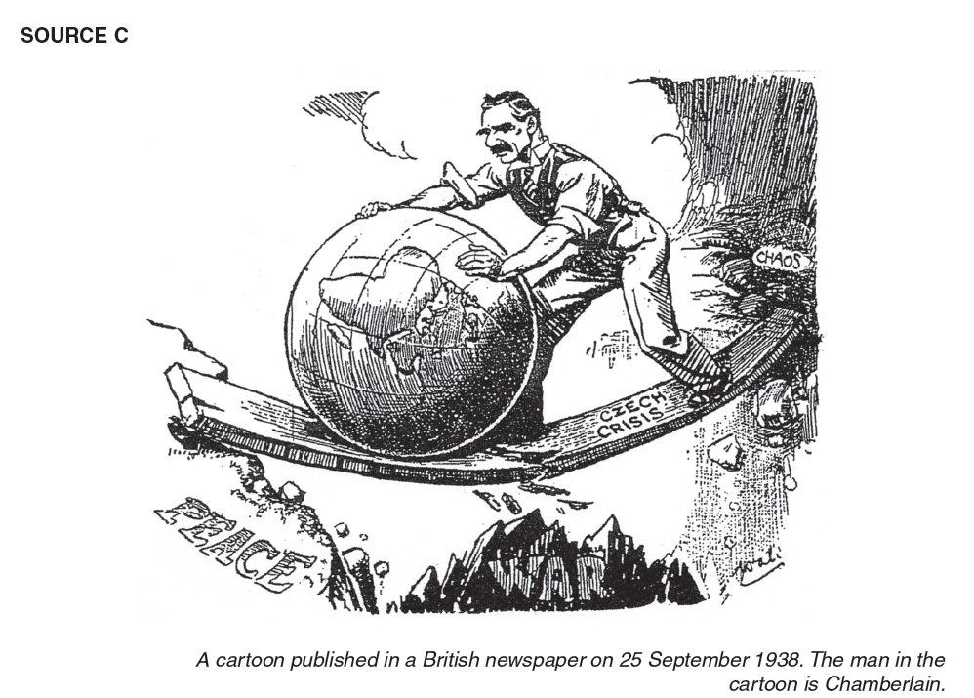

Slide 7
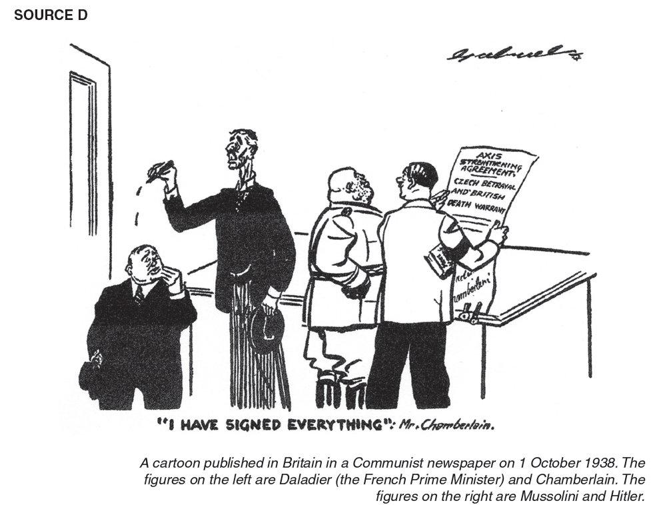

Slide 8
Question 2

Slide 9
Question 2
Do question 2 from the same paper you looked at for homework
You have 20 mins (enough time to look at the sources and write without rushing)
Do without talking

Slide 10
Marking your answer
Find page 5, paper 22 (8 pages in)
Mark your own answer, using the mark scheme provided
Indicate in the margin where the different levels appear
Give yourself a score out of 8
Give yourself a target to improve your score (if 8 then think about timing, level of detail etc)

