Slide 1
DATE
Paper 2 Reliability/Trust Questions

Slide 2
(Potentially) Violent Watching
https://www.youtube.com/watch?v=dPigk1Zz418

Slide 3
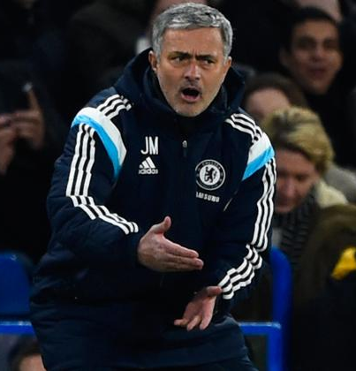
Do you trust this source?

Slide 4
Top Tips for a reliability/trust question
Explain in what way you think the sources are reliable or unreliable. You must explain your answer by evaluating the source. There are always ‘clues’ you can look for when assessing the reliability of any source:
1) WHO wrote it – did they stand to gain or lose from what they wrote?
2) HOW it is written – is the language especially emotive (over the top) or biased.
3) WHAT is written – does it contradict your own knowledge of the person or event?
4) CROSS REFERENCING - Do other sources in the paper support or contradict the source? This can be from any source or background information.
‘When asked whether or not you trust a source, it is reasonable to assume that there might be some reason not to, though, of course, there may also be aspects of it that are trustworthy. Some answers simply accepted what the source said, often on the basis that it was true because it agreed with the candidates knowledge of the events. Alternatively, the source was rejected on the basis that it was biased, written too long after the events, or by someone who was not even [there]. Answers based only on asserting (lack of) reliability meet only surface requirements; what is required is an explanation of how and why the source may be seen as (un)reliable. In other words the answer needs to evaluate the source.

Slide 5
Reliability checklist
Who produced it?
How is it produced?
Why did they produce it?
When did they produce it?
Can it be backed up with knowledge?
Can it be backed up by any other source?

Slide 6
Doh! Moments.
Just because it was written at the time does not make something reliable.

Slide 7
Doh! Moments.
Just because the author was a historian does not make the source reliable.

Slide 8
Doh! Moments.
Just because the source is a photograph does not make it reliable.

Slide 9
Doh! Moments.
Just because the source is long/complex does not make it reliable.

Slide 10
Doh! Moments.
Answers do not need balance like a comparison question.

Slide 11
Question 4

Slide 12
Question 3

Slide 13
Question 4
Do question 4 from the same paper you looked at for homework
You have 15 mins (enough time to look at the sources and write without rushing)
Do without talking

Slide 14
Marking your answer
Find page 6, paper 22 (9 pages in)
Mark your own answer, using the mark scheme provided
Indicate in the margin where the different levels appear
Give yourself a score out of 7
Give yourself a target to improve your score (if 8 then think about timing, level of detail etc)

