Slide 1
Do this question without talking
15 mins
Practice makes perfect (sad but true)

Slide 2
DATE
Paper 2 Message and Purpose Questions

Slide 3
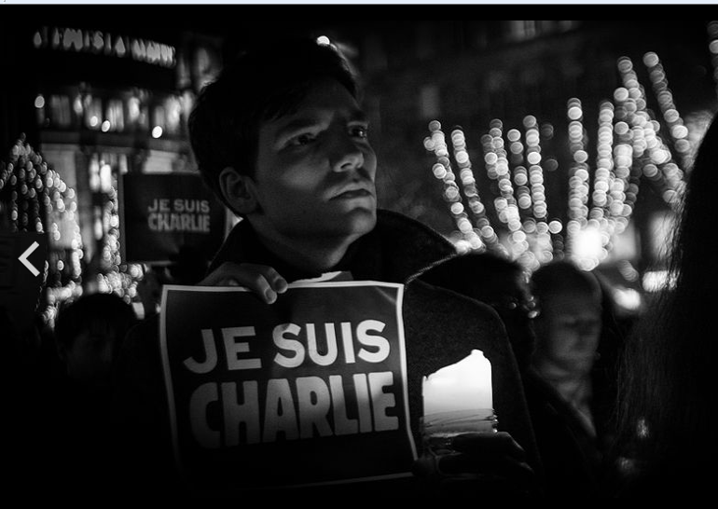
Charlie Hebdo Attacks

Slide 4
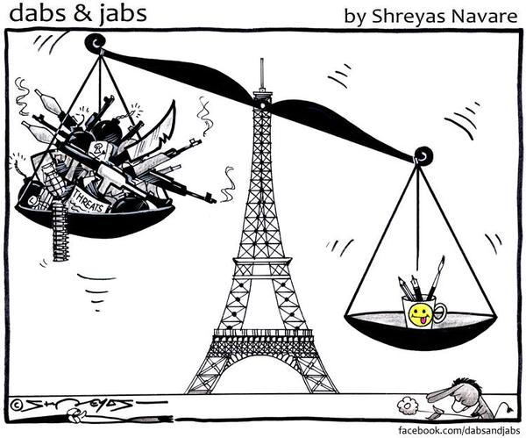
Why was this cartoon published in 2015?

Slide 5
Top Tips for a purpose question
To tackle this type of question you need to work out the message of the source then think about what the author of the source would want to achieve by getting that message across. Usually this would involve:
Changing people’s attitudes
Changing people’s behaviour (e.g. getting them to join a movement or contribute funds to a particular cause)

Slide 6
Purpose!
C
M
P
ontext
.
essage
.
urpose

Slide 7
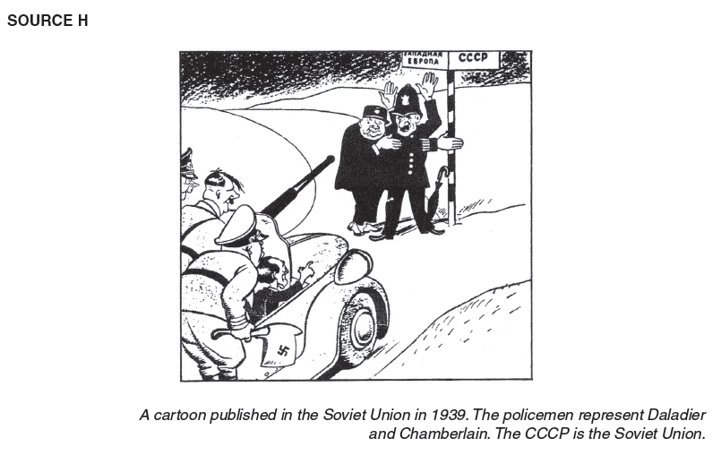
Question 5

Slide 8
Question 5

Slide 9
Question
Study source C.
Why was this cartoon published IN September 1938? (8)

Slide 10
Marks
1 – Writes about source, no reference to question
2 – Explains some of the source
3 – Uses the context of 1938 but not message
4 – Explains message (sub messages) and context
5 – Explains the source’s purpose
6 – Explains purpose in the context of 1938 (needs ‘big message’ also)

Slide 11
Question 5
Do question 5 from the same paper you looked at for homework
Bullet point answer plan

Slide 12
Marking your answer
Find page 6, paper 22 (9 pages in)
Mark your own answer, using the mark scheme provided
Indicate in the margin where the different levels appear
Give yourself a score out of 7
Give yourself a target to improve your score (if 8 then think about timing, level of detail etc)

Slide 13
Where we are up to
Comparison questions
Reliability questions
Purpose questions

Slide 14
Still to come
5. Surprise questions (next)
6. Question 6 (Tuesday)
7. Past paper assessment (Tuesday 12th March)
Homework: revise content

